Slide 1
NJ SCHOOLS HEALTH FUND

Slide 2
ABOUT TELLIGEN

Slide 3
Proposed Solutions for the Fund

Slide 5
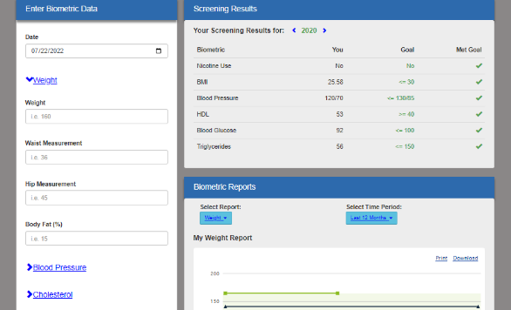
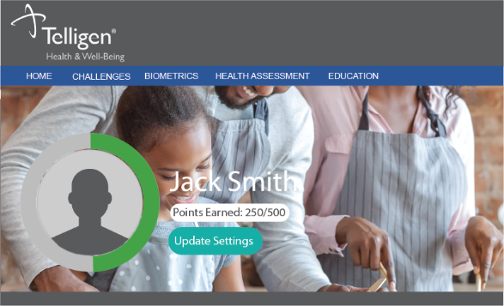
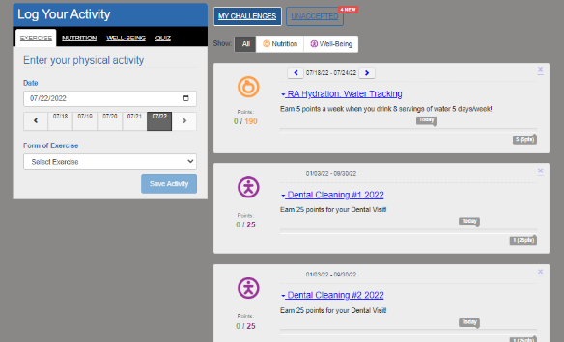
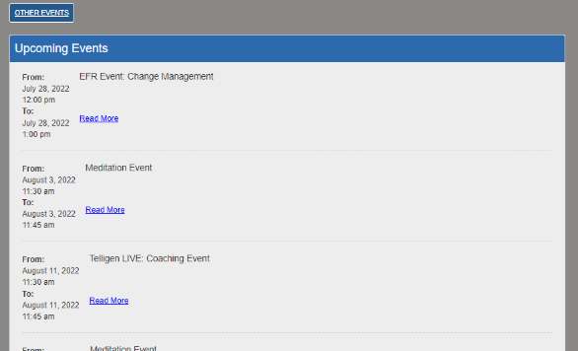
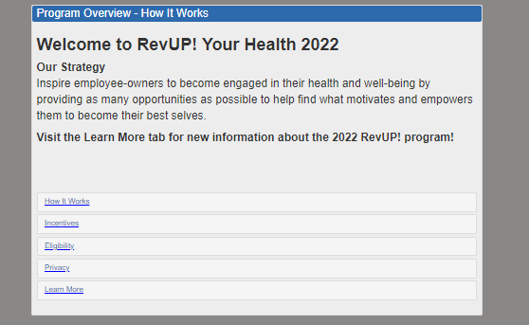
Wellness Portal
FEATURES
Challenges
Events
Biometrics
Educational Materials
Program Information

Slide 6
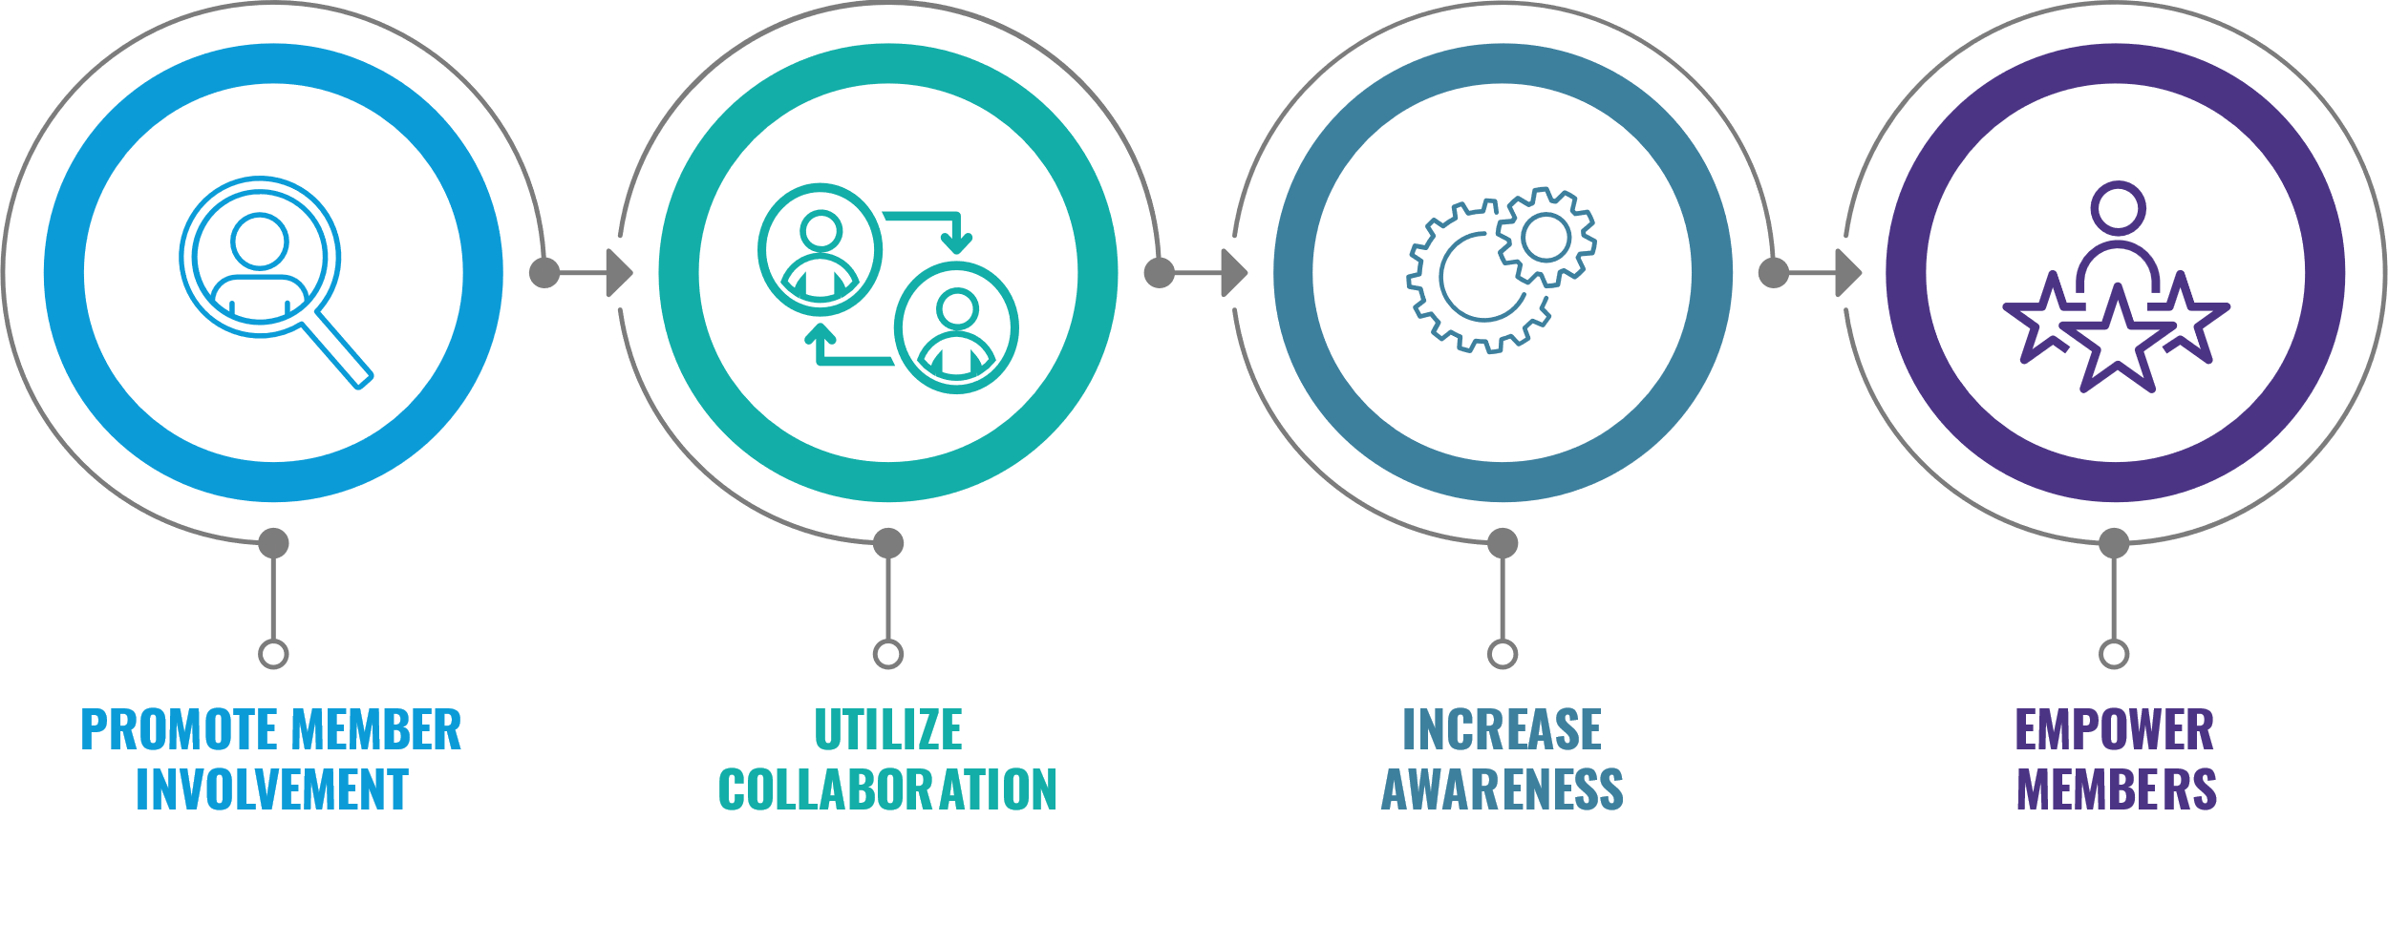
Coaching Engagement Philosophy
Members actively engage in coaching or treatment plan every step of the process
Telligen experts collaborate with members, providers, and/or treatment teams to support member’s health
Telligen experts educate members on their condition(s) and provide resources to improve health
Throughout the process, members learn how to take charge of their health and make informed choices

Slide 7
Tools for Engagement
Turnleaf Wellness Portal & Mobile App
Remote Monitoring
Virtual Group Coaching Program

Slide 8
Turnleaf Demo
Notes:
Click on slide to play the video

Slide 9
Remote Monitoring
Supplies members with an electronic monitoring device specific to their condition
Teach members on appropriate use of the device & how to read the data
Enables Telligen nurse case managers to help members develop regular condition monitoring behaviors to manage acute and chronic conditions in real-time.
Provides the member and case manager with a continuous stream of health data through the Telligen app to monitor trends, behaviors and symptoms.
The nurse and member will create goals and an action plan tailored to the member’s specific health goals.
The case manager and member will use the health data to collaborate with the member’s care team for treatment and lifestyle improvement.

Slide 10
Virtual Coaching Programs
Designed for members to take in their own time, at their own pace
Supported by scheduled calls with their Telligen health coach in between sessions.
The self-guided courses feature educational videos, check-in quizzes in between sessions and ongoing communication with the members’ dedicated health coach.
Self-guided courses are available for at-risk coaching in the areas of
weight loss
diabetes prevention
musculoskeletal conditions.

Slide 11
The Impact on Employee Health & Health Costs

Slide 12
AT-RISK MEMBER JOURNEY: JAINE
Employee Identified Through Biometrics
MEMBER IMPACT
Weight loss
Changed behaviors
Lost 18 lbs. during 9 mos. engaged in coaching
Continued coaching and appreciates an accountability partner
Makes herself a priority
TELLIGEN ROI
4.5 Member Satisfaction Score (1-5 Scale)
40% Improvement in Metabolic Syndrome
43% Improvement in Waist Circumference
At-Risk Member Testimonial
Coach Obtains Patient Activation Measure (PAM) Score
BACKGROUND
Participated in employer-sponsored wellness program
Identified through metabolic markers
Goal: Weight Loss
Action Plan: Journaling food and increasing exercise
Initial and Ongoing Coach & Employee Goal Setting
Education for Employee/Provider Collaboration and Resources
Calls & Mobile App Communication Regarding Progress

Slide 13
DISEASE MANAGEMENT MEMBER JOURNEY: LEONARD
Disease Management Member Testimonial
Enrolled in DM Following Identification
MEMBER IMPACT
Has lost almost 80 lbs.
Has dropped almost 10 BMI points
No longer has to take diabetes and hypertension medication
Exercises 5 days/week
Drinks 1 gallon of water/day
TELLIGEN ROI
2.1:1 ROI
Over 85% Improvement in evidence based medical adherence
Coach Obtains Patient Activation Measure (PAM) Score
BACKGROUND
Participated in employer-sponsored wellness program
Identified through medical & pharmacy claims
Goal: Weight loss & diabetes management
Action Plan: Diet, exercise, water
Coach works with provider and sets goals with employee on bloodwork and weight
Education for Employee/Provider Collaboration and Resources
Calls & Mobile App Communication Regarding Progress

Slide 14
CASE MANAGEMENT MEMBER JOURNEY: JOE
Case Management Cancer Testimonial
Enrolled in CM Following Identification
MEMBER IMPACT
Hospital admission to ICU was avoided and kept weight stable
Chose evidence-based clinical trial saving the Fund thousands of dollars
TELLIGEN ROI
3.4:1 ROI
4.7 Member Satisfaction Score (1-5 Scale)
40% Reduction in ER Usage
$11,229,939+ in Savings for 2022 within the Telligen Book of Business for CM!
Nurse CM Obtains Patient Activation Measure (PAM) Score
BACKGROUND:
Participated in employer-sponsored Case Management Program
Identified through medical and pharmacy claims
Plan: Support member through cancer journey to achieve best outcomes for client & member
Nurse CM collaborates with provider and employee regarding treatment plan
Education for Employee/Provider Collaboration and Resources
Calls & Mobile App Communication Regarding Status & Treatment

Slide 15
Member & Client Testimonials
One of my goals was to eat healthier, and my coach recommended resources regarding habits so that I understood what goes into them that transcended into all of my goals not only nutrition, personal and professional and my relationships.
I had a resource in this coach that was committed to helping me. In the past three months, I've focused on one goal, and everything fell into place with her help. I feel more like myself than I have in a very long time.
I really like working with my coach to get an external perspective and as another big bonus, I get along with her really well. She understands me, making the experience enjoyable. I consider her a friend now.
Telligen is an excellent health management partner. They bring strong data analytics, collaboration and innovative solutions to the table.

Slide 16
With Telligen, Clients Receive:

Slide 17
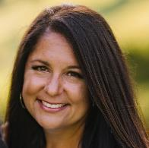
Contact Us
Ami Bolles
Director, Account Management
abolles@telligen.com
Anna Vander Beek
Account Manager
avanderbeek@telligen.com

